Slide 1
Hotel Reviews
Exploratory Data Analysis and Visualization

Slide 2
Content
Project Scope
Customer Heatmap
Terms and their Associations
Topic Review
Sentiment Analysis
Text Analysis
Analysis of Data Content
Analysis by Location
Density Analysis

Slide 3
Project Scope
We used a 10,000 Hotel reviews sample from 2018, to explore and visualize the data from different angles to identify what makes the Guests to give a good review to a Hotel location, and how this can be correlated to provide actionable intelligence to the Management Team.
Reviews include all states an is categorized by the type of industry based on each platform’s definition, i.e. TripAdvisor.

Slide 4
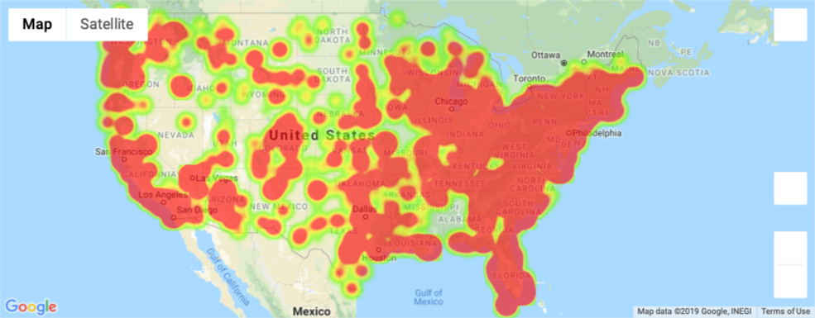
Customer Heatmap
Initially, we used the data to identify the locations where the comments are coming from. This can provide a visual of the high customer concentration areas, and be used as a valuable intelligence tool for marketing campaigns, further develop specific markets, and focus on retention efforts. An additional layer can be added to identify the highest spend areas.

Slide 5
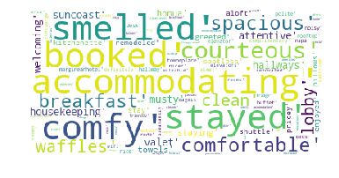
Terms and their Associations
An easy way to show a quick visual of the general reviews is through a word cloud. Hotels could use this on their monthly boards to show employees how are the Guests looking at them, and develop plans to engage each team on improving that visual.
Top 100 most common words

Slide 6
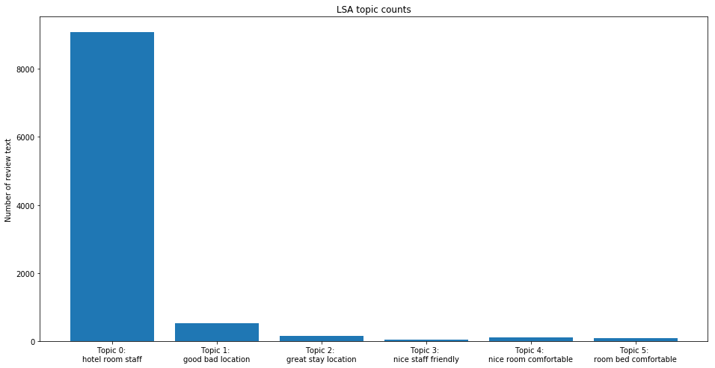
Topic Review
The analysis can identify the most common topics found in all the reviews. This is a great tool to identify the items that the property needs to focus on to improve Customer perception. Topics can be tailored to the top 3,5 most positive or negative, or as many as the Management Team requires.
5 Most Common Topics
Topic 0: hotel room staff
Topic 1: good location
Topic 2: great stay location
Topic 3: nice staff friendly
Topic 4: nice room comfortable
Topic 5: room bed comfortable

Slide 7
Sentiment Analysis
Sentiment analysis is the process developed to identify and understand the polarity of the reviews submitted by Guests, categorized as positive, neutral or negative, using a scale from -1 to 1, where 1 represents the most positive comments.
5 Positive Reviews
Great room! Plenty of space for 4 people
Loved the breakfast!! It was wonderful.
Nothing the location and the front desk girls were excellent.
Great staff and well taken care of facility!
Great room! Plenty of space for 4 people
5 Negative Reviews
Loved the breakfast!! It was wonderful.
Nothing the location and the front desk girls were excellent.
Great staff and well taken care of facility!

Slide 8
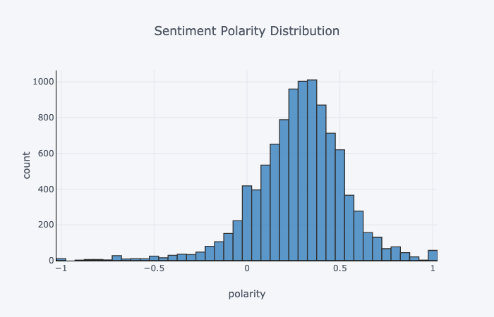
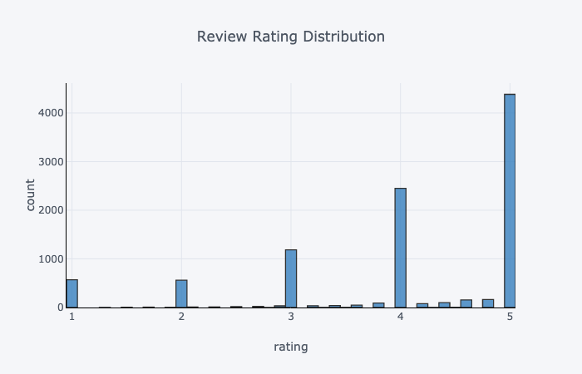
Sentiment Analysis
Plotting the polarity distribution shows the general sentiment on the reviews posted. In the example above most of the reviews are between 0 and 0.5, which represents a general positive trend.
All ratings given to Hotels, in a scale from 1 to 5, where 5 is the highest, are then compared to the sentiment polarity to confirm their correlation.

Slide 9
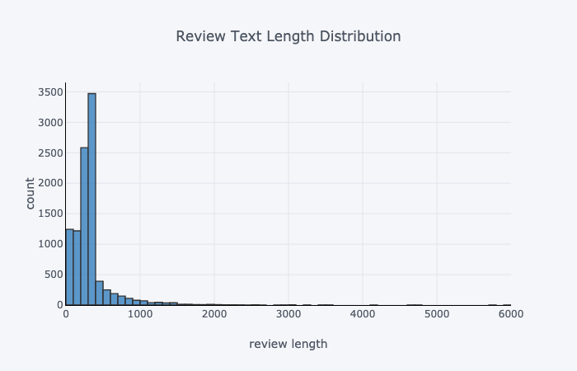
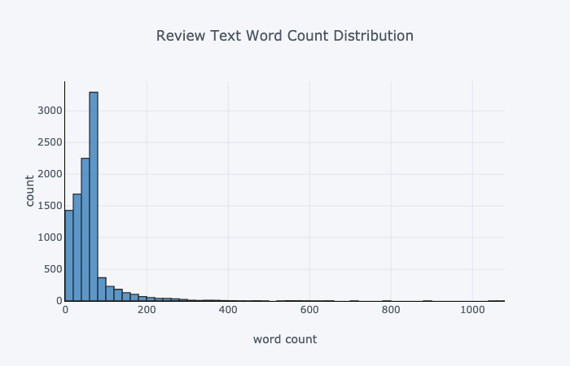
Text Analysis
This process represents a detailed analysis of the text content in all the reviews, including text length, word count, and word associations using unigrams, bigrams, and trigrams to identify the most relevant content in the reviews.

Slide 10
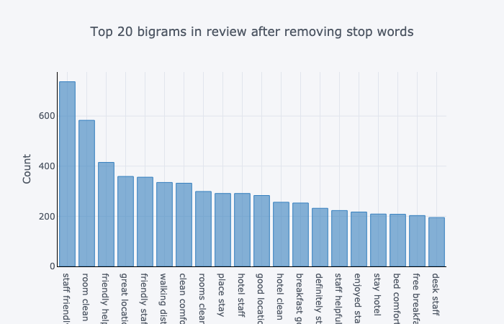
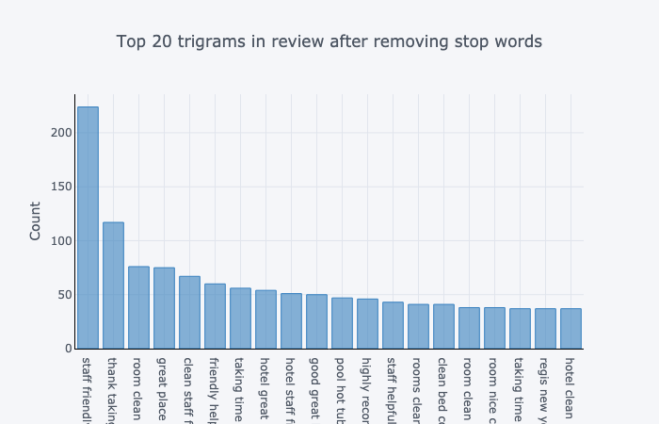
Text Analysis
The text analysis can be used to identify what is the most positive and negative language from the Guests, and create a correlation that will allow the Hotels to develop specific action plans for improvement.

Slide 11
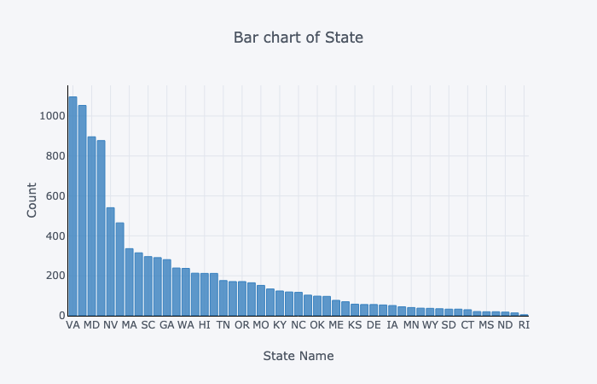
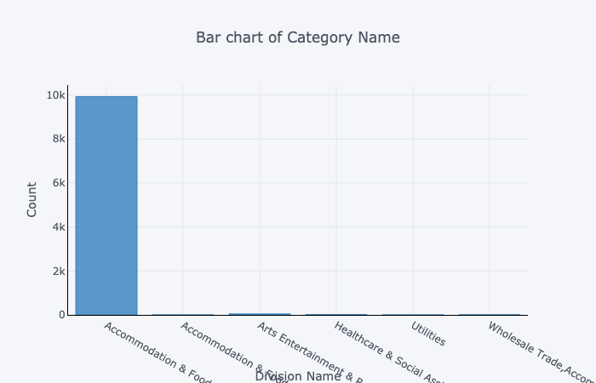
Analysis of Data Content
Analysis can be made based on the different categories contained in the data set, and can be expanded to all locations, or narrowed down to specific properties, locations, or even areas within the property.

Slide 12
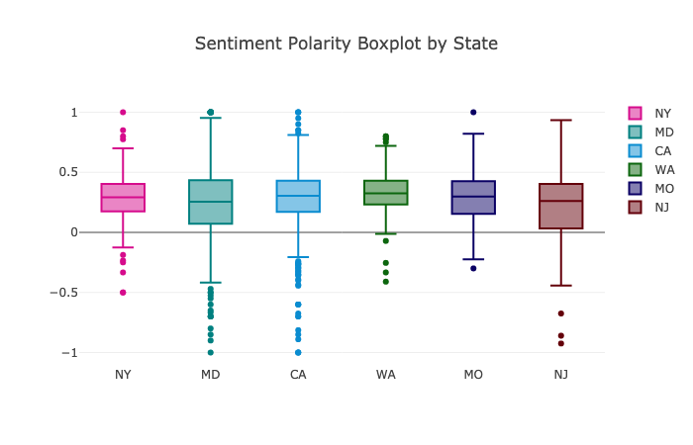
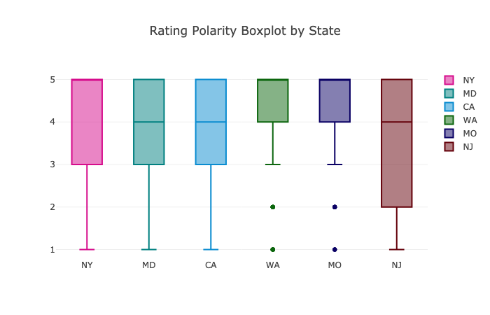
Analysis by Location
This is an example of the analysis of the sentiment polarity made to 6 specific locations, and as explained before, an unlimited number of locations and variables can be added.

Slide 13
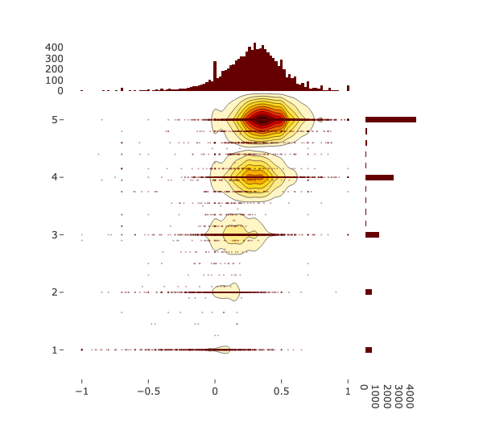
2D Density Jointplot
This analysis shows the correlation between sentiment polarity and the ratings posted by the Guests, and provides a visual of where is the largest density of that correlation.
Sentiment polarity vs. rating

Slide 14
Guest Analysis
Additional analysis can be performed and provide intelligence in different categories, like:
Top Spend by Customer
Correlation of Spend and Reviews
Frequency/Number of Stays
Seasonality Analysis by Customer
Prediction of Room Nights by Location/Customer/Geography
Prediction of Spend by Location/Customer/Geography

Slide 15
Conclusion
Do you have several sources of data?, is your data nor reliable?, is it not “clean”?, does it provide any valuable insights?
Talk to us, any data set can be cleaned, improved, analyzed, and provide valuable information to make better management decisions.

Slide 16
Contact Us
G&S Business Solutions 562 Marrus Circle Richmond Heights, OH 44143 Phone: 216-973-0852 email: gastonalvarado1971@gmail.com

Slide 17
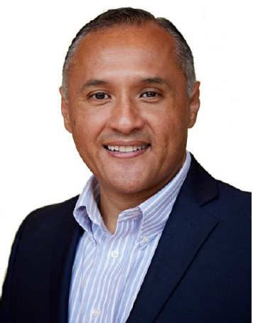
Personal Brand
Procurement professional with over 20 years of experience in Indirect Procurement. Extensive qualifications in partnering with business, leadership, and teams to define needs, develop and implement Procurement Programs that have delivered substantial savings and enhanced best practices in several Fortune 500 companies in the United States, Mexico, Canada, and all major regions across the world, working across different industries like Manufacturing, Travel, Insurance, Financial, and retail. Experienced negotiator, well versed in global commodity, program management, and supplier development.
An expert communicator, well versed in presenting to executive staff and driving cross-functional collaboration across varied organizational subcultures, and global teams. Proficient in data analysis, well versed in Excel, VBA, Excel, Python, SQL & HTML, which integrated with the acquired professional expertise delivers a unique set of well-rounded skills for collecting, cleaning, analyzing, and strategically visualize data to transform Executive’s decision making from data to insights.

Slide 18
Company Information
G&S was established in 2015 and provides consulting services to start up businesses. Specializing in Data Analysis, Contracts, Procurement, and Finance.
We help Companies to improve their revenues, increase their customer base, and set enhanced strategic plans using data analytics and prediction model tools.

Slide 19
Q&A

